Slide 1

Deep Learning Approaches to Profiling & Predicting Organizational Threats – NEXTGEN SOC
Project ID - 24-25J-075
IT21298608 – D.H. SenevirathnA (L)
IT21380396 – M.F.F. Ashra
IT21058196 – K.P.A.T. Gunawardhana
IT21226496 – W.M.M. Gunasekara

Slide 2



Content of the Presentation
01.
Introduction to the overall project
o2.
Research Problem
o3.
Research Objectives
o4.
Organizational Threat profiling with Human behavior analysis
o5.
Organizational Threat profiling with network traffic analyze
06.
Organizational Threat profiling with Endpoint Data
07.
Organizational Threat profiling with Physical Security Systems
04/12/2024

Slide 3
Introduction to the overall project
Evolving cybersecurity landscape with increasingly sophisticated threats.
Need for NextGen SOCs to handle volume and complexity of attacks.
Potential of deep learning to analyze vast, heterogeneous data.
Research focus on profiling and predicting organizational threats.
Integration of network traffic, endpoint logs, physical security systems, and human behavior data.
Develop modern SOCs for improved threat detection and response.
04/12/2024

Slide 4
Research Problem
Organizations face increasingly complex and sophisticated cyber threats that traditional Security Operations Centers (SOCs) struggle to manage. NextGen SOCs must utilize deep learning to enhance threat profiling and prediction. However, integrating diverse data sources, adapting to evolving threats, ensuring scalability, and maintaining ethical standards present significant challenges. This research aims to develop advanced deep learning models to accurately profile and predict organizational threats, addressing these critical challenges to improve organizational security.
04/12/2024

Slide 5
Research Objectives
Threat Profiling with Endpoint Data
Threat Profiling with Physical Security Systems
Threat Profiling through Human Behavior Analysis
Threat Profiling with Network Traffic Analysis
04/12/2024

Slide 6

Organizational Threat profiling with Human behavior analysis
IT21298608|Senevirathna D.H.
specialize in cybersecurity

Slide 7
Overview
This component focuses on Organizational Threat Profiling using Human Behavior Analysis. It integrates multiple data sources like user activities, device usage, psychometric traits, and decoy file interactions. Key features include analyzing patterns such as logon frequency, device access, and psychological attributes (OCEAN traits). A machine learning model predicts insider threats by combining these behavioral and psychological factors. The system is designed for real-time threat detection, offering insights through visualizations.
IT21298608 | Senevirathna D.H. | 24-25J-075
04/12/2024

Slide 8
Overview dataset
The CERT Insider Threat Detection Dataset was used to train the model for insider threat profiling. It contains data that captures behavioral patterns of employees within an organization, aimed at identifying potential insider threats.
Features: Includes user roles, logon frequencies, device activities, and psychological traits (OCEAN: Openness, Conscientiousness, Extraversion, Agreeableness, Neuroticism).
Data Categories:
User Data: Profiles with details like department, team, and supervisor.
Logon Activities: Records of logons, logoffs, and timestamps.
Device Interactions: Access logs for organizational devices.
Psychometric Data: Traits analysis for employee personality profiling.
Decoy Files: Monitors access to sensitive bait files.
04/12/2024
IT21298608 | Senevirathna D.H. | 24-25J-075

Slide 9
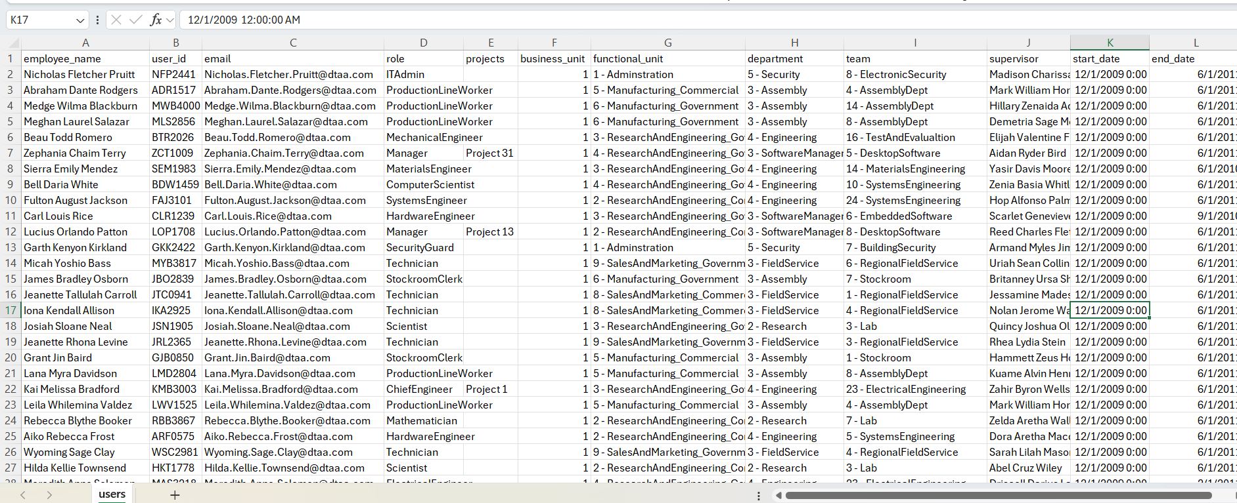
Overview dataset
04/12/2024
IT21298608 | Senevirathna D.H. | 24-25J-075

Slide 10
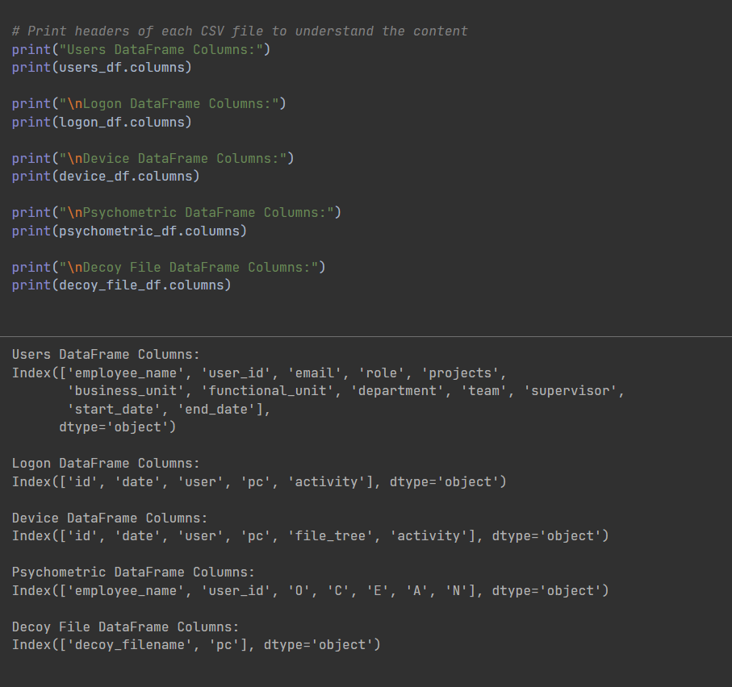
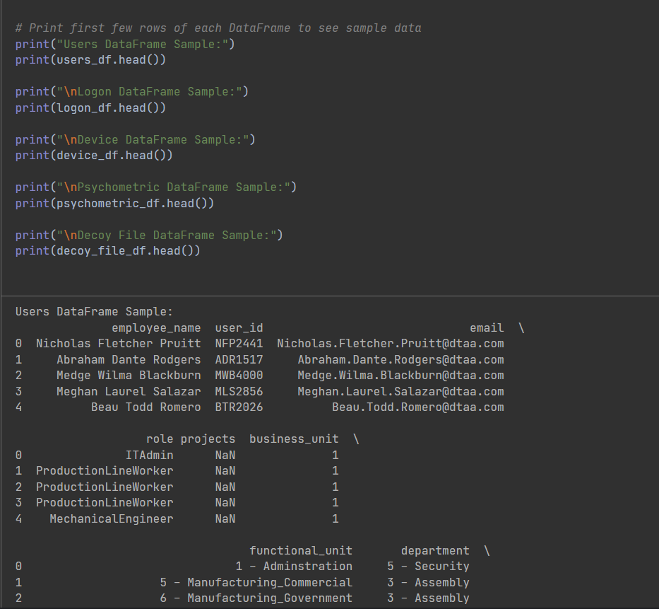
Content Of Dataset
Rows of Data frame
Headers of CSV files
04/12/2024
IT21298608 | Senevirathna D.H. | 24-25J-075

Slide 11
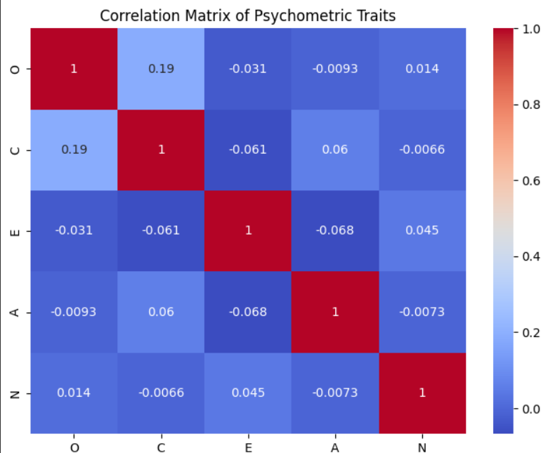
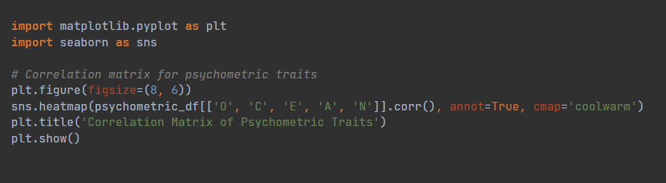
Analyzing Behavioral Patterns and Activity
Correlation matrix for psychometric traits
04/12/2024
IT21298608 | Senevirathna D.H. | 24-25J-075

Slide 12
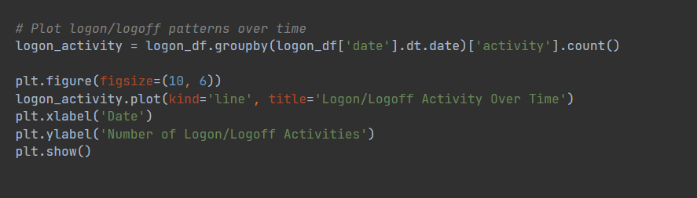
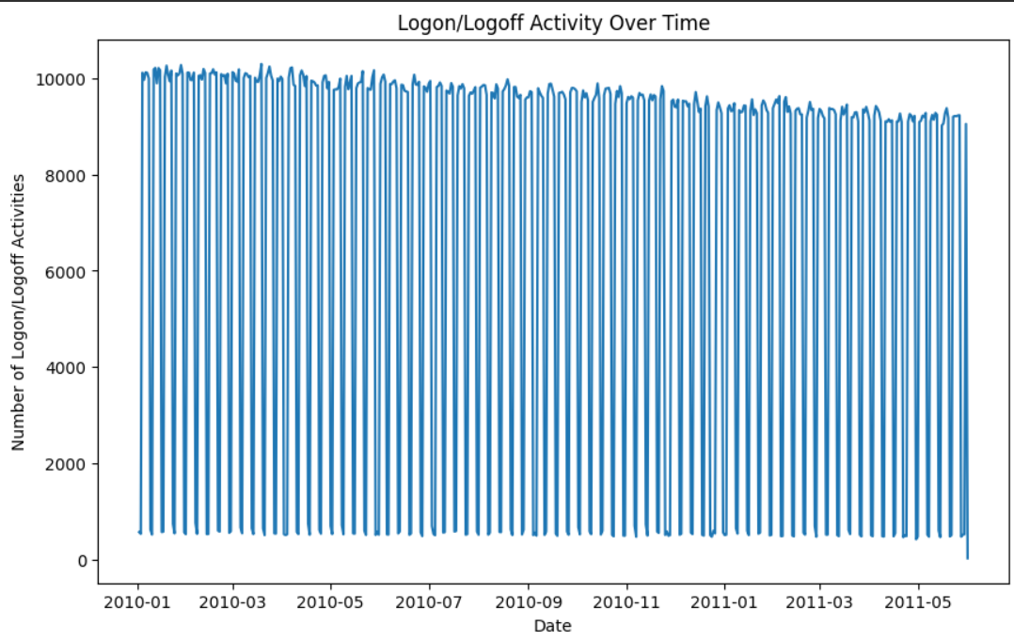
Analyzing Behavioral Patterns and Activity
Logon/Logoff patterns over time
04/12/2024
IT21298608 | Senevirathna D.H. | 24-25J-075

Slide 13
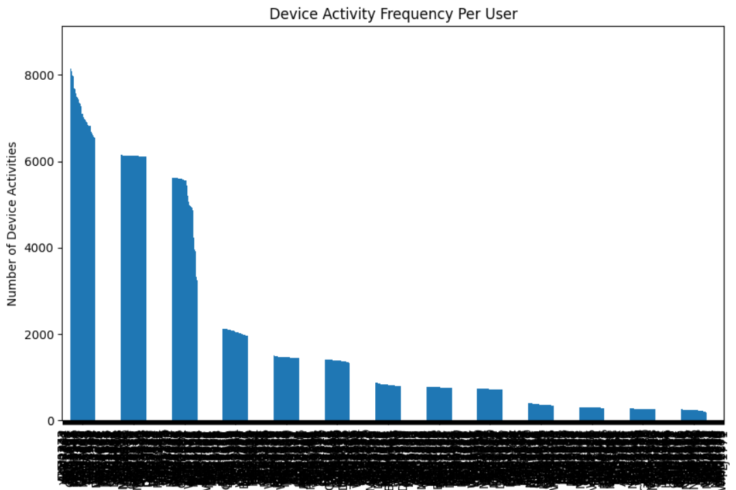
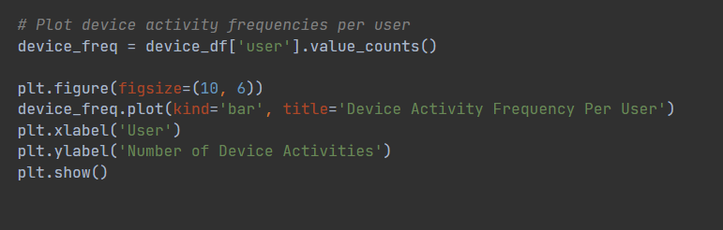
Analyzing Behavioral Patterns and Activity
Device activity frequencies per user
04/12/2024
IT21298608 | Senevirathna D.H. | 24-25J-075

Slide 14
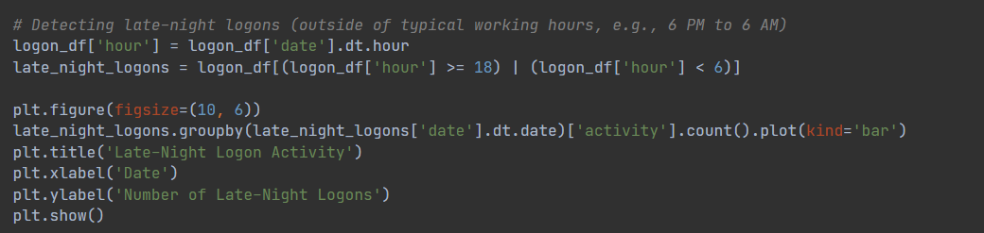
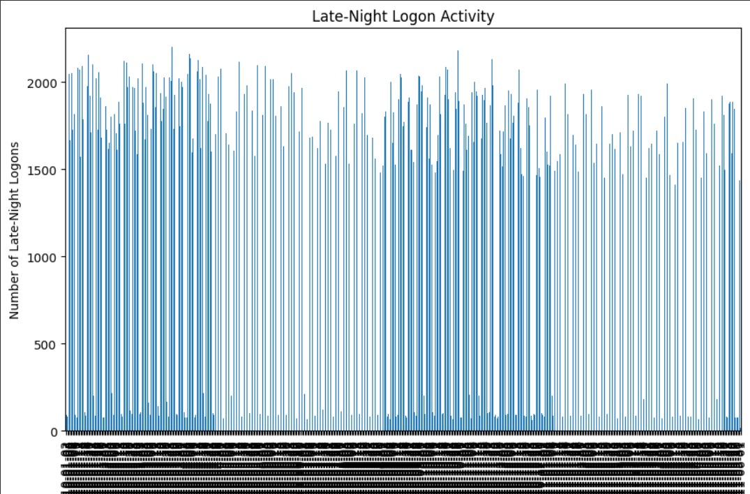
Analyzing Behavioral Patterns and Activity
Late night Logon Activity
04/12/2024
IT21298608 | Senevirathna D.H. | 24-25J-075

Slide 15
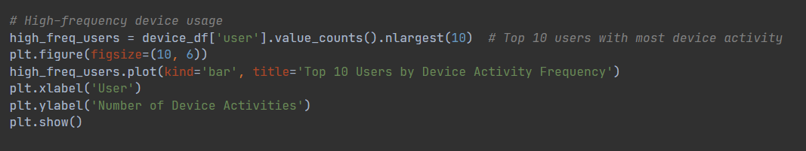
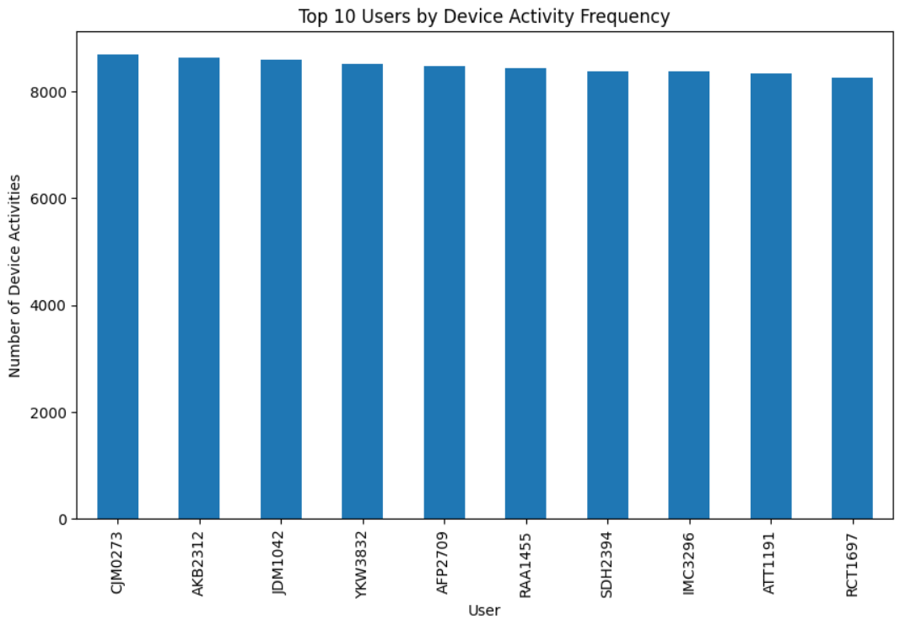
Analyzing Behavioral Patterns and Activity
High Frequency Device Usage
04/12/2024
IT21298608 | Senevirathna D.H. | 24-25J-075

Slide 16
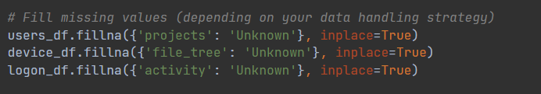
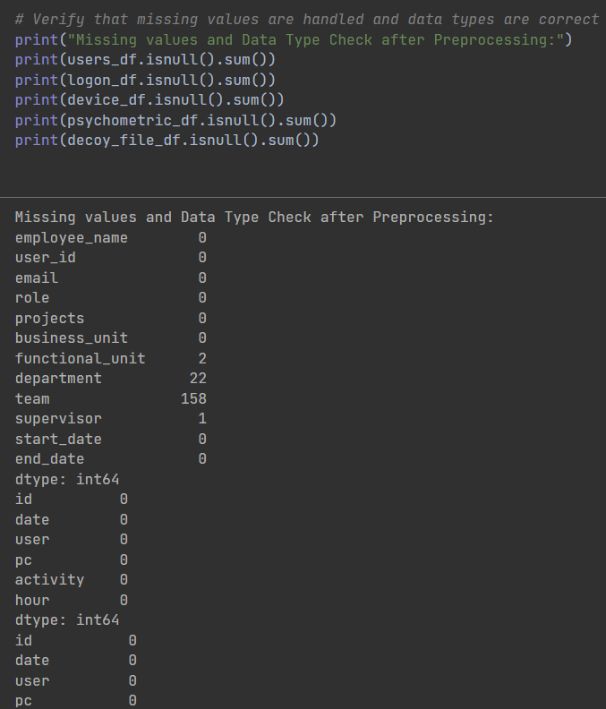
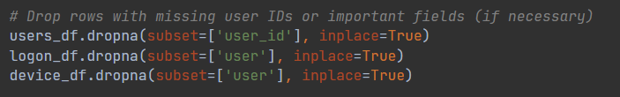
Data Preprocessing
Verify missing values are handled and data types are correct
Filling missing values
Drop rows with missing important fields
04/12/2024
IT21298608 | Senevirathna D.H. | 24-25J-075

Slide 17
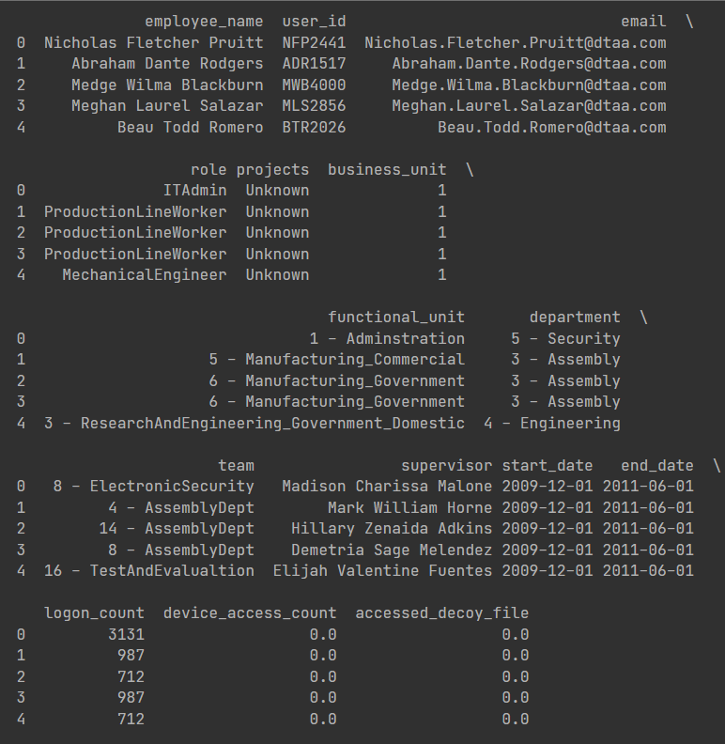
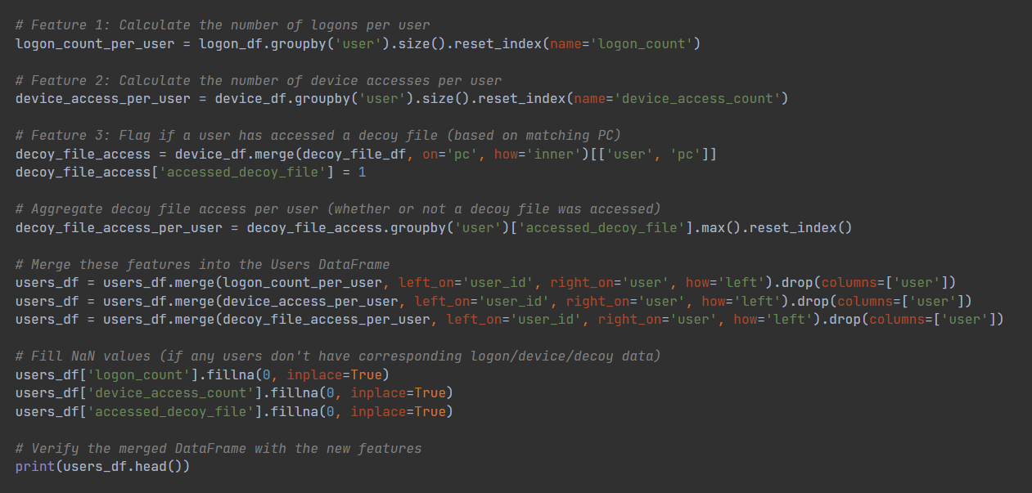
Data Preprocessing
Create features and merge into the user DataFrame
04/12/2024
IT21298608 | Senevirathna D.H. | 24-25J-075

Slide 18
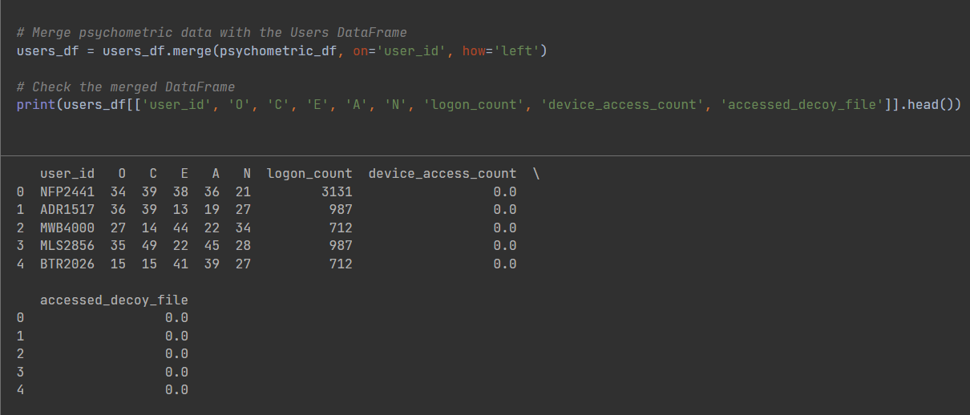
Data Preprocessing
Merge Psychometric data with the users DataFrame
04/12/2024
IT21298608 | Senevirathna D.H. | 24-25J-075

Slide 19
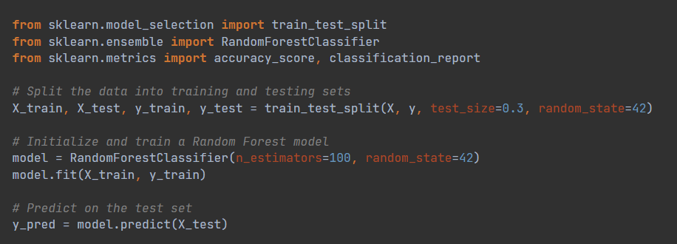
Train the dataset Using Random Forest Model
The dataset was split into 70% for training and 30% for testing.
A Random Forest Classifier with 100 trees and a fixed random state was used to ensure consistent results.
04/12/2024
IT21298608 | Senevirathna D.H. | 24-25J-075

Slide 20
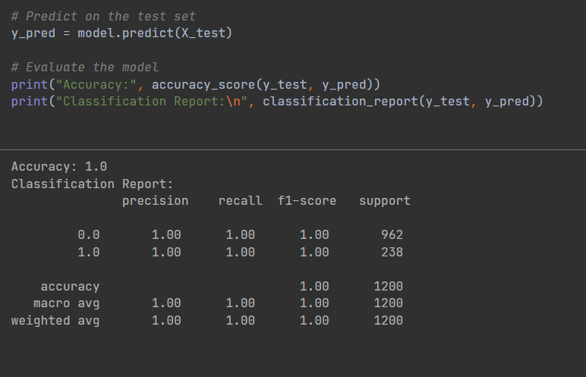
Model Evaluation Results
Accuracy: The model achieved an accuracy of 1.0, indicating perfect performance on the test data.
Precision: 1.0 for both classes, showing that the model correctly identified positive and negative cases.
Recall: 1.0 for both classes, meaning the model detected all actual positive and negative cases.
04/12/2024
IT21298608 | Senevirathna D.H. | 24-25J-075

Slide 21
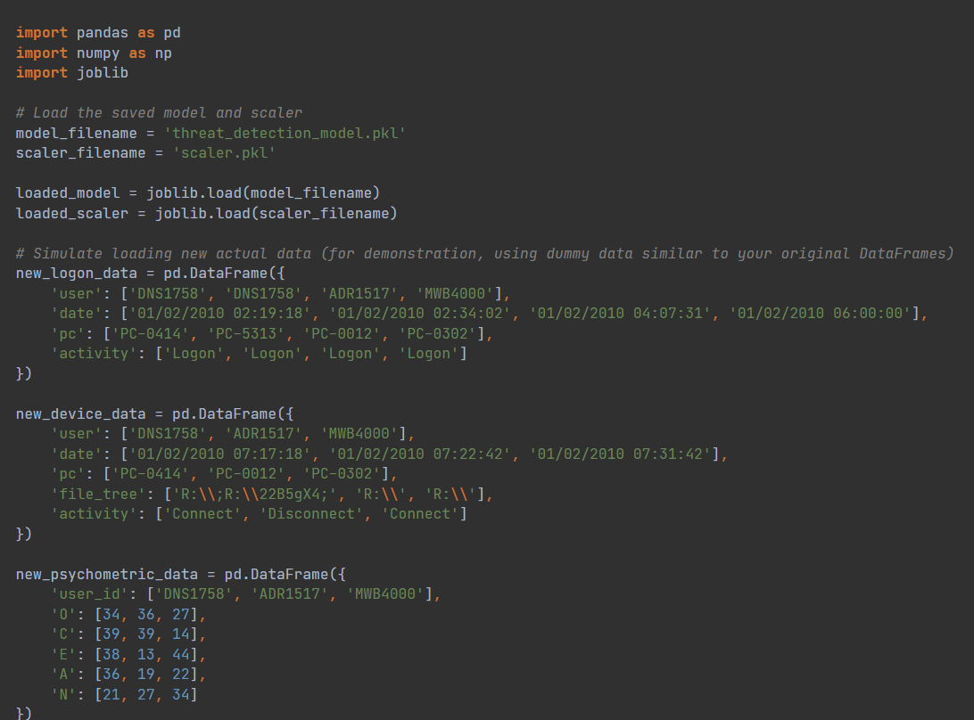
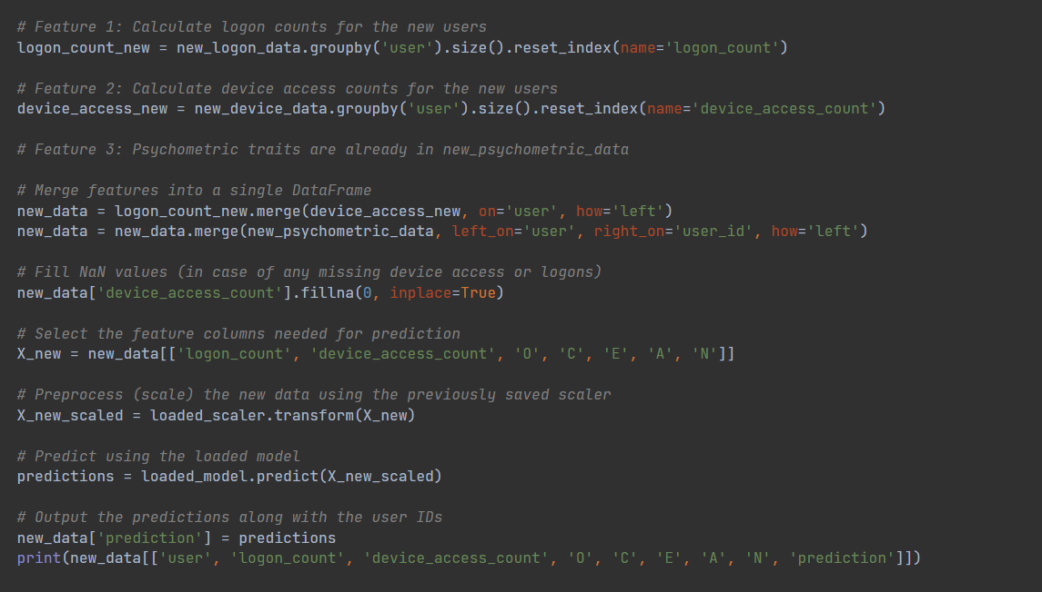
Model Prediction
04/12/2024
IT21298608 | Senevirathna D.H. | 24-25J-075

Slide 22
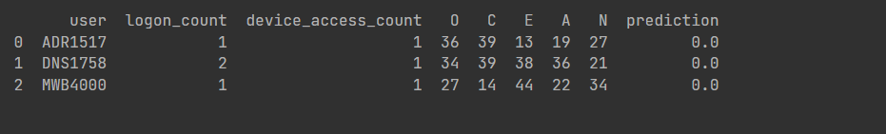
Prediction Results
Displayed predictions for each user, showing if they were classified as "benign" (0.0) or "potential threat" (1.0).
Presented relevant features for each user, such as logon counts, device access counts, and personality traits.
04/12/2024
IT21298608 | Senevirathna D.H. | 24-25J-075

Slide 23
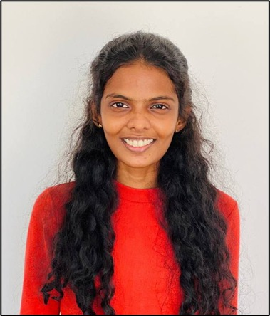
Organizational Threat profiling with network traffic analyze
IT21226496 | W.M.M. Gunasekara
specialize in cybersecurity

Slide 24
Overview
Network traffic analysis focuses on examining patterns and anomalies within network data to detect and classify abnormal behavior effectively. Utilizing advanced machine learning techniques such as Generative Adversarial Networks (GANs), neural networks, and decision tree classifiers, this component ensures precise anomaly detection by analyzing key network metrics. By identifying deviations from normal traffic behavior, this component provides good and efficient methods for detection and classification, essential for maintaining the integrity of network operations.
04/12/2024
IT21226496 | Gunasekara W.M.M. | 24-25J-075

Slide 25
Overview dataset
The dataset used is the CICIDS 2017 Dataset, available on Kaggle (link). This dataset is designed for anomaly detection in network traffic. It contains:
Simulated attack scenarios, including Brute Force, DoS/DDoS, Web Attacks, Port Scans, and more, captured across multiple days.
79 features: Covering network metrics such as flow duration, packet size, and traffic rates.
Labeled data for supervised learning and anomaly detection, providing an ideal resource for training models to differentiate between benign and malicious traffic.
04/12/2024
IT21226496 | Gunasekara W.M.M. | 24-25J-075

Slide 26
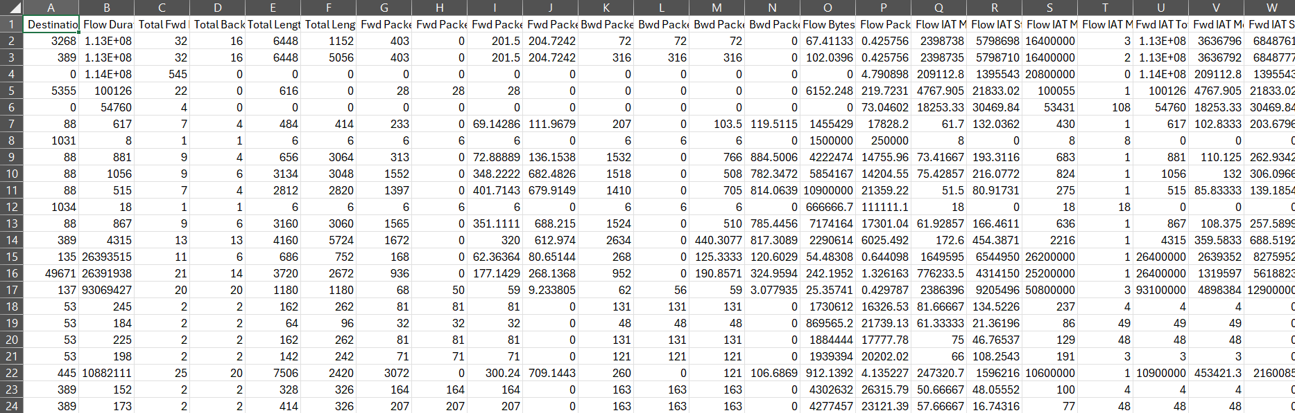
Overview dataset
04/12/2024
IT21226496 | Gunasekara W.M.M. | 24-25J-075

Slide 27
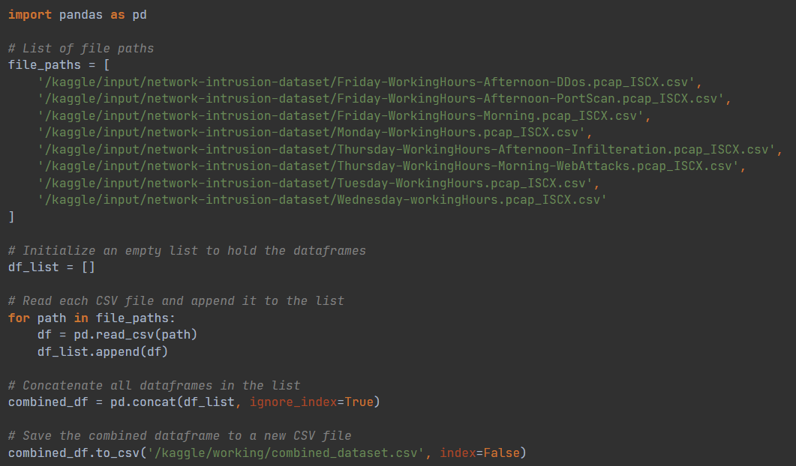
Loading Dataset
04/12/2024
IT21226496 | Gunasekara W.M.M. | 24-25J-075

Slide 28
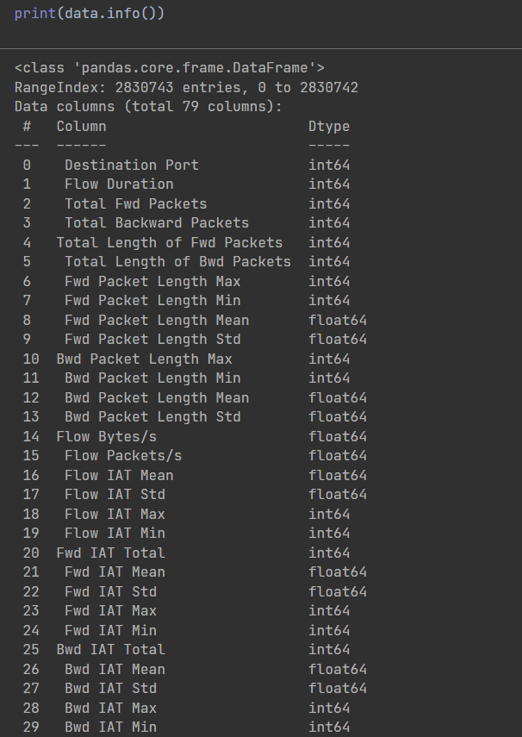
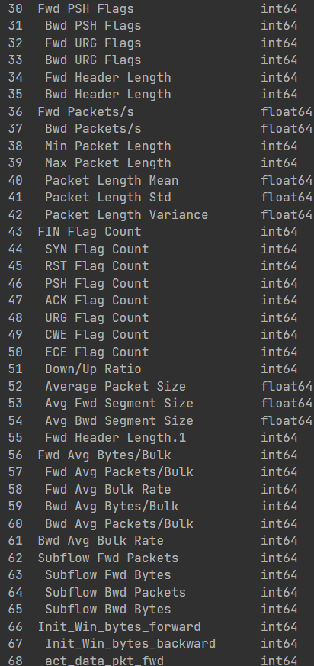
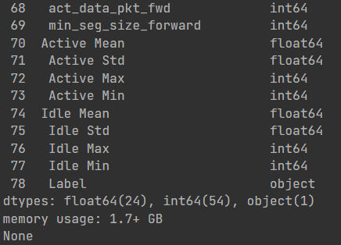
Content of Dataset
04/12/2024
IT21226496 | Gunasekara W.M.M. | 24-25J-075

Slide 29
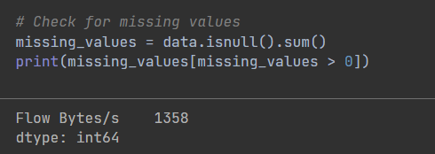
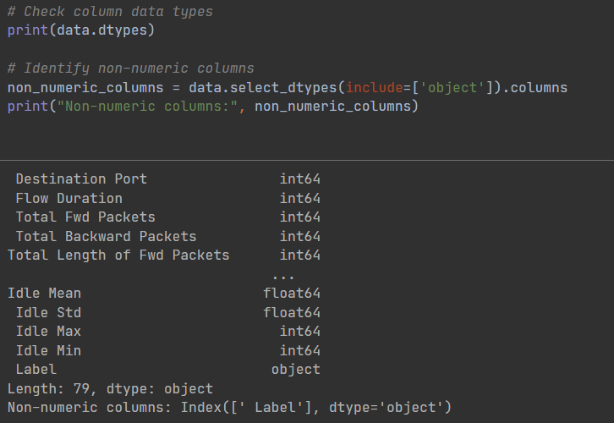
Content of Dataset
04/12/2024
IT21226496 | Gunasekara W.M.M. | 24-25J-075

Slide 30
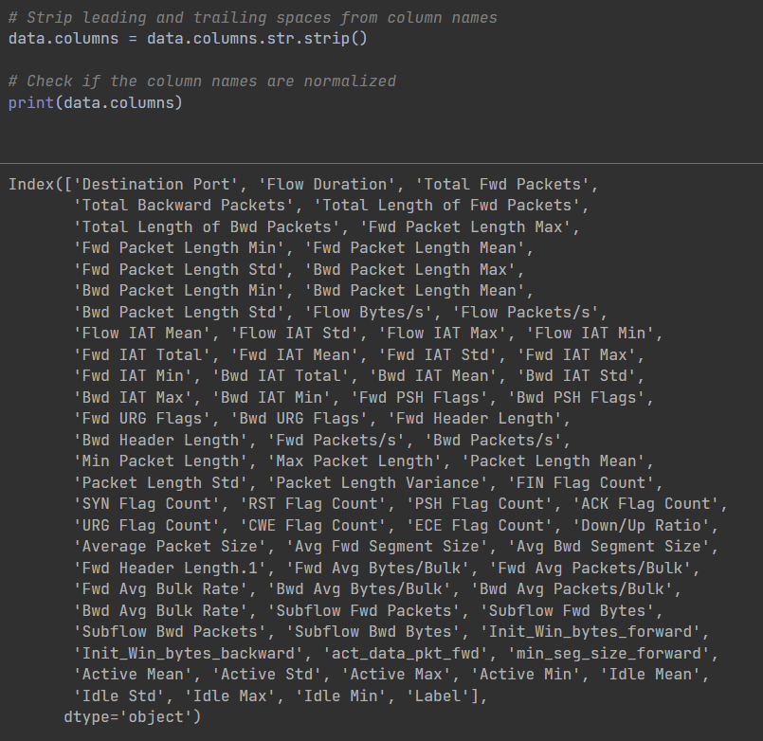
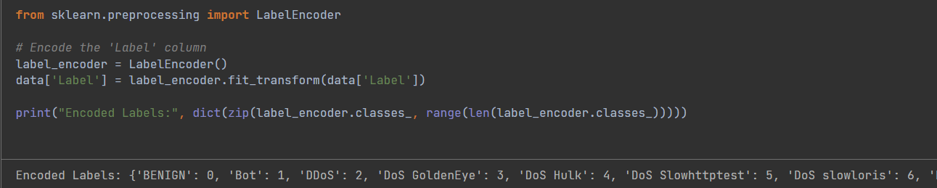
Content of Dataset
04/12/2024
IT21226496 | Gunasekara W.M.M. | 24-25J-075

Slide 31
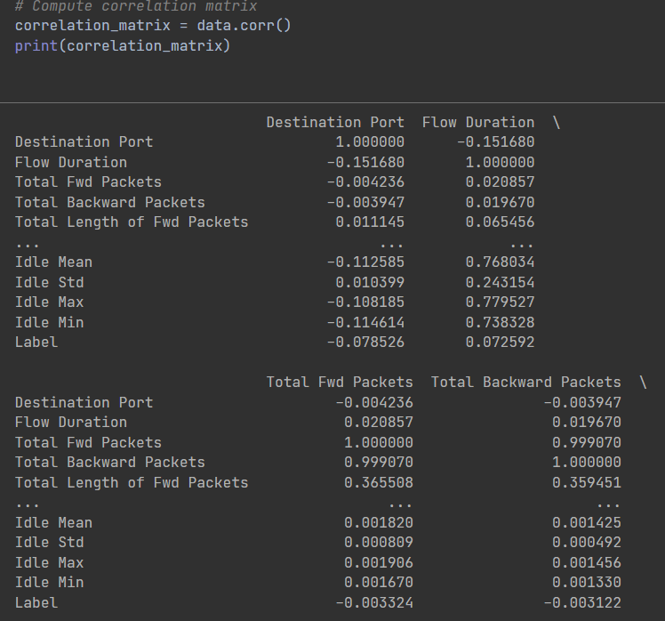
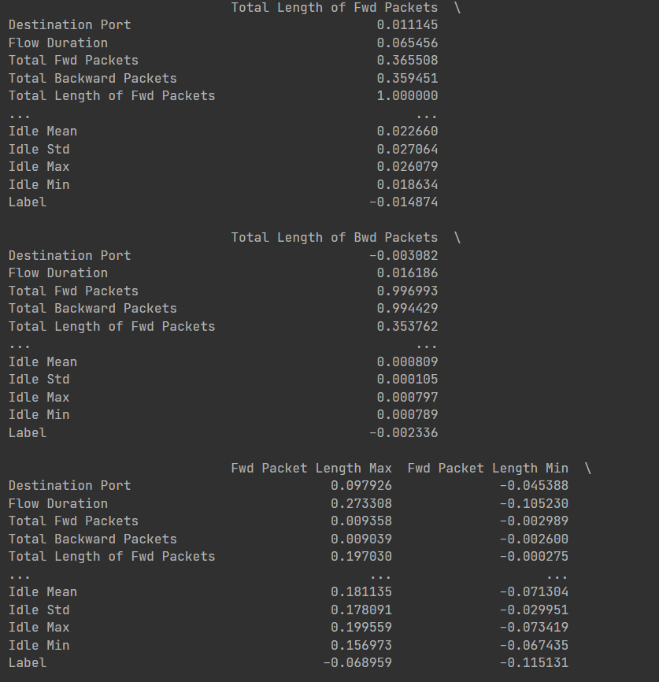
Correlation Matrix
04/12/2024
IT21226496 | Gunasekara W.M.M. | 24-25J-075

Slide 32
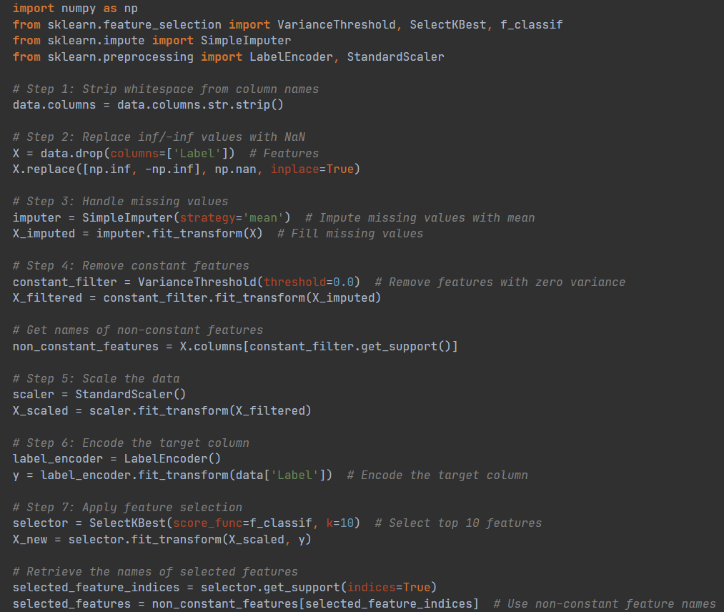
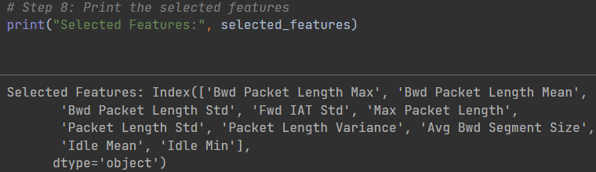
Top Ten Selected Features
04/12/2024
IT21226496 | Gunasekara W.M.M. | 24-25J-075

Slide 33
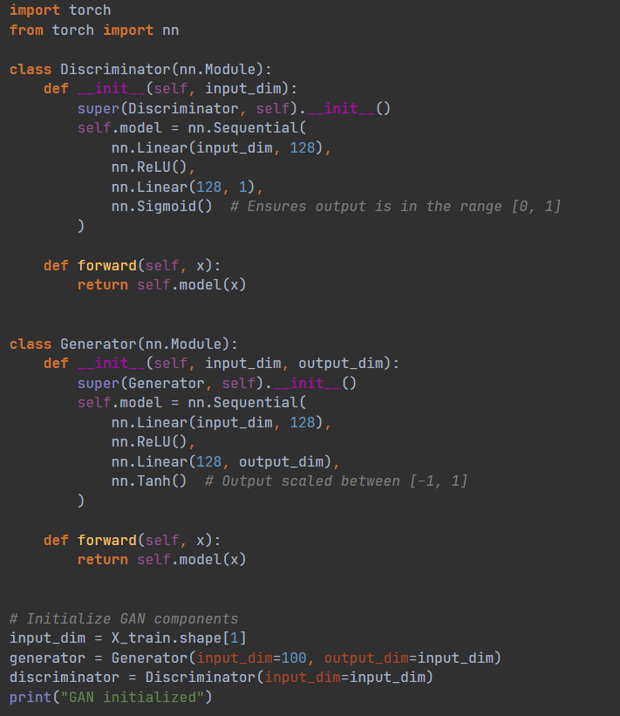
Generative Adversarial Model (GAN)
Layers:
Both the Generator and Discriminator models use fully connected layers with 128 neurons in the hidden layer, offering simplicity and effectiveness in learning complex patterns.
Activation Functions:
ReLU: Introduces non-linearity, allowing the model to learn complex patterns from data.
Tanh: Scales the output of the Generator between -1 and 1 for realistic data generation.
Sigmoid: Ensures the output of the Discriminator is a probability between 0 and 1, indicating whether the data is real or fake.
04/12/2024
IT21226496 | Gunasekara W.M.M. | 24-25J-075

Slide 34
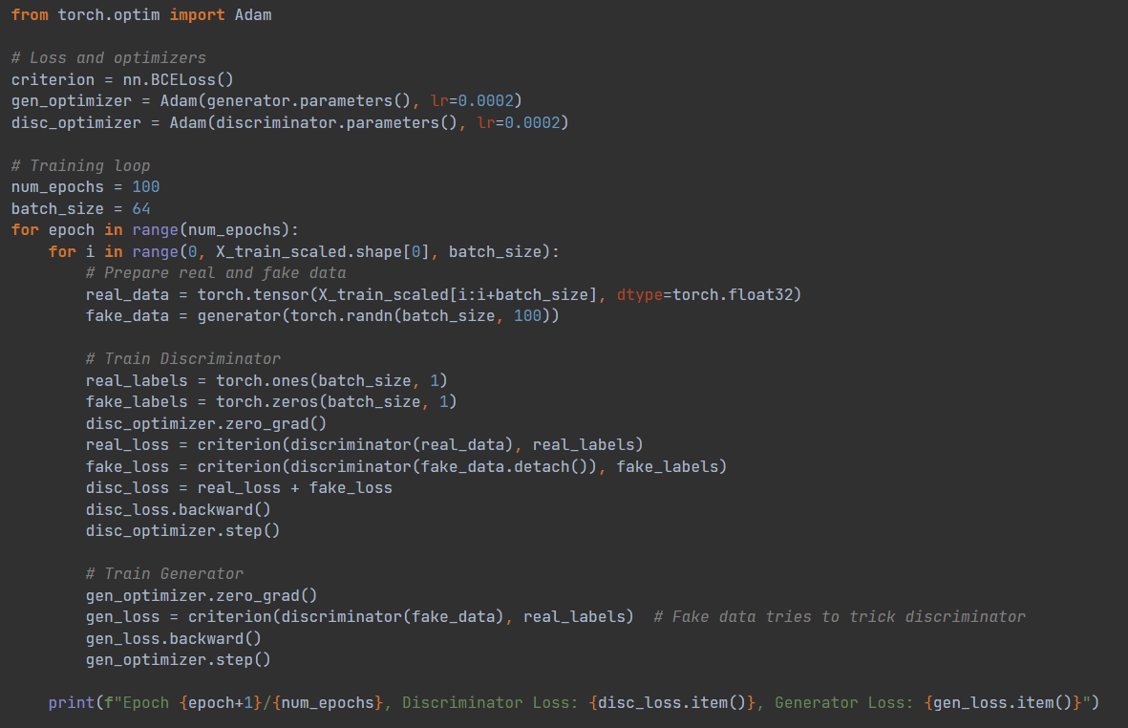
Optimizers & Loss Function:
Adam Optimizer: Used for both Generator and Discriminator to update weights.
BCELoss: Calculates binary cross-entropy loss for classification (real vs. fake).
Discriminator Training:
Learns to classify real data (from the dataset) as 1 and fake data (from the Generator) as 0.
Generator Training:
Aims to fool the Discriminator by generating fake data that is classified as real (label = 1).
Training Loop:
Loss values for the Discriminator and Generator are printed after each epoch to monitor performance.
04/12/2024
IT21226496 | Gunasekara W.M.M. | 24-25J-075

Slide 35
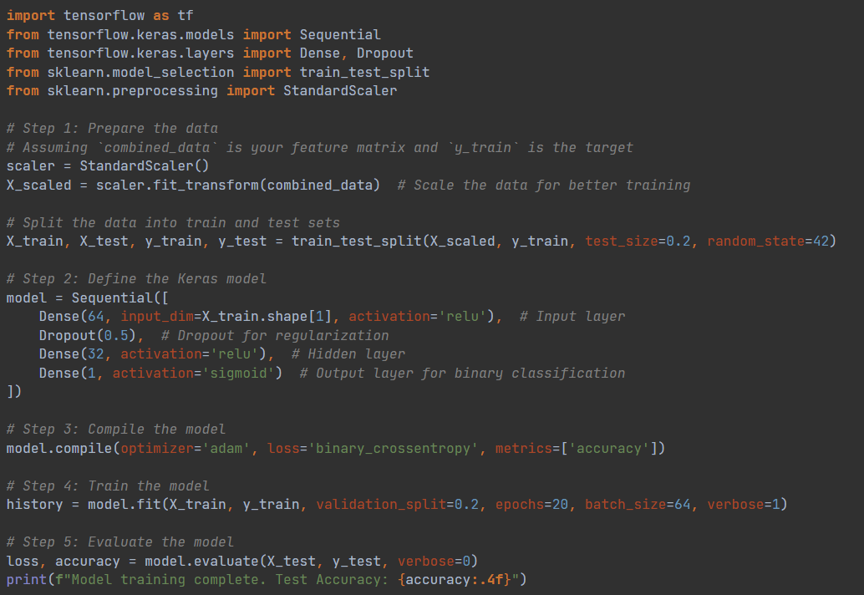
Training a Neural Network
The model is trained on scaled network traffic data to classify it as normal or anomalous. It uses a simple neural network with 64 and 32 neurons in the hidden layers, followed by a sigmoid output for binary classification. The model is trained for 20 epochs using the Adam optimizer and binary cross-entropy loss.
04/12/2024
IT21226496 | Gunasekara W.M.M. | 24-25J-075

Slide 36
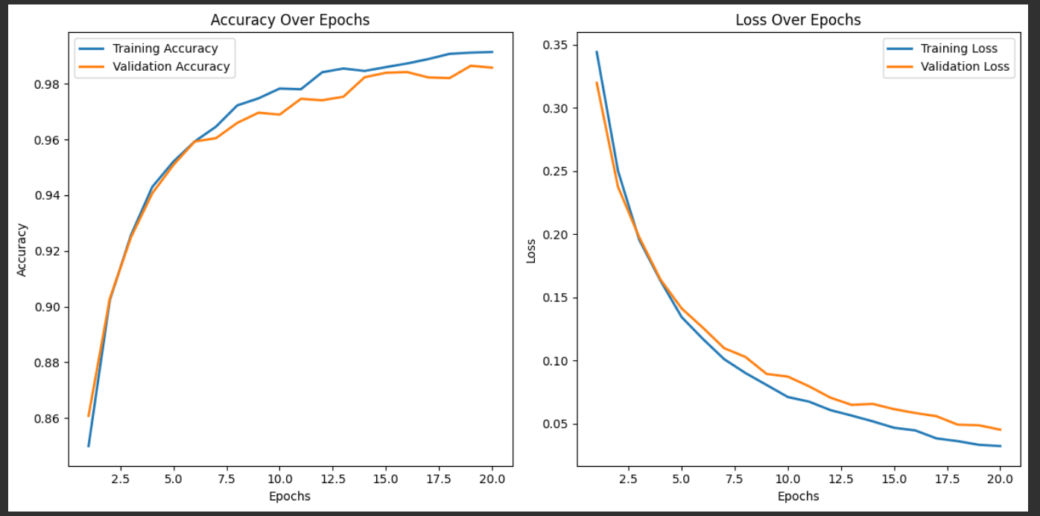
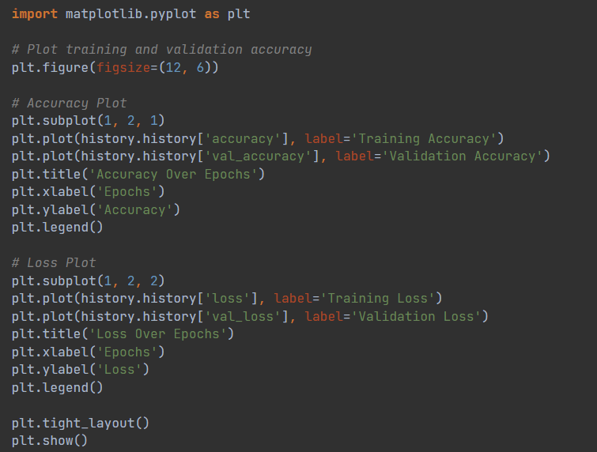
Training and Validation Metrics Over Epochs
04/12/2024
IT21226496 | Gunasekara W.M.M. | 24-25J-075

Slide 37
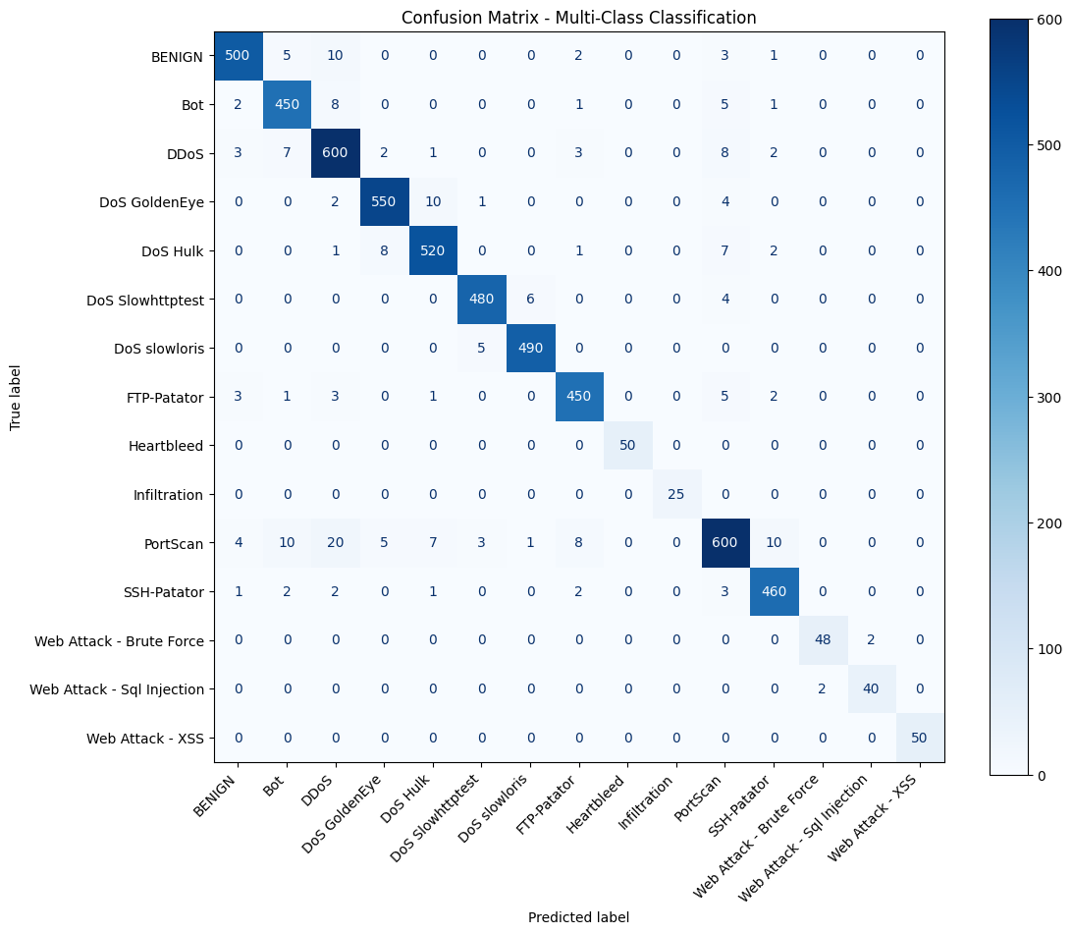
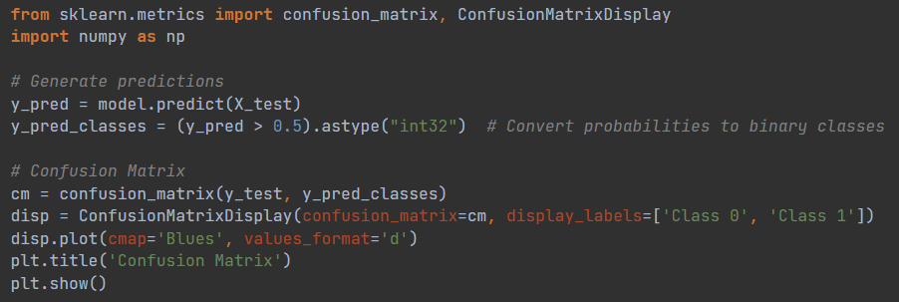
Confusion Matrix
04/12/2024
IT21226496 | Gunasekara W.M.M. | 24-25J-075

Slide 38
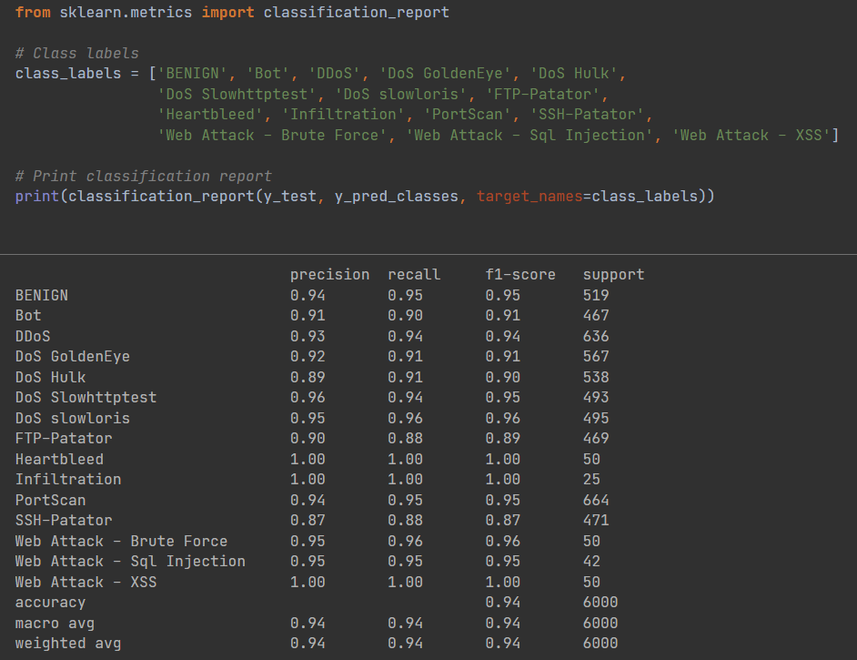
Classification Report
Model has achieved an Accuracy of 94%.
04/12/2024
IT21226496 | Gunasekara W.M.M. | 24-25J-075

Slide 39
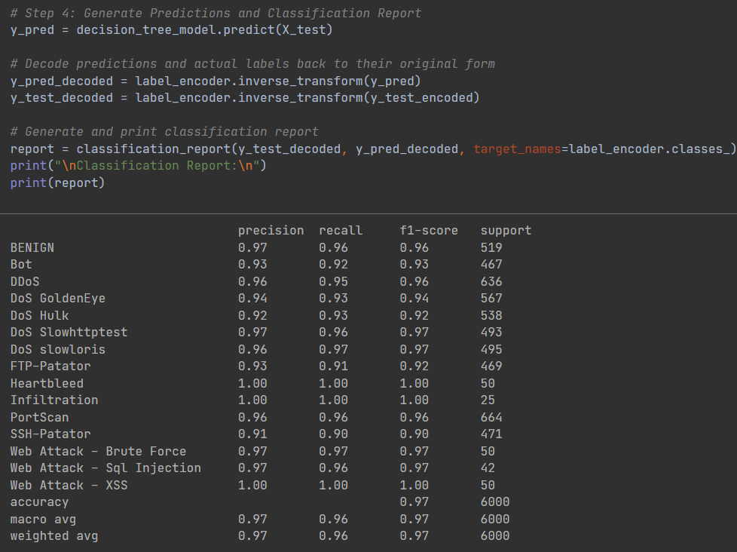
Decision Tree Classifier
Model has achieved an Accuracy of 97%.
04/12/2024
IT21226496 | Gunasekara W.M.M. | 24-25J-075

Slide 40

Organizational Threat profiling with Endpoint Data
IT21380396 | M.F.F. Ashra
specialize in cybersecurity

Slide 41
Overview
"Organizational Threat Profiling with Endpoint Data" focuses on identifying network anomalies that may indicate security threats using machine learning models. By analyzing network traffic data, the system classifies traffic as either "normal" or "anomalous." The Random Forest and Neural Network models are trained on this data to detect unusual behavior that could suggest potential security risks. By profiling endpoint data, the system provides a real-time mechanism for detecting and responding to threats, enhancing organizational security by monitoring endpoint behaviors effectively.
04/12/2024
IT21380396 | Ashra M.F.F. | 24-25J-075

Slide 42
Overview of the Dataset
This dataset serves as a foundation for building machine learning models to profile and detect abnormal network behavior, assisting in organizational threat profiling using endpoint data.
It includes features such as capturing TCP/IP connections, each represented by features such as connection duration, protocol type, service, source and destination bytes, error rates, and login attempts.
The dataset includes both numerical and categorical data.
The target variable, class, labels each entry as either "normal" or "anomaly".
These attributes are crucial for profiling threats at the organizational level by analyzing network traffic and endpoint behavior.
IT21380396 | Ashra M.F.F. | 24-25J-075
04/12/2024

Slide 43
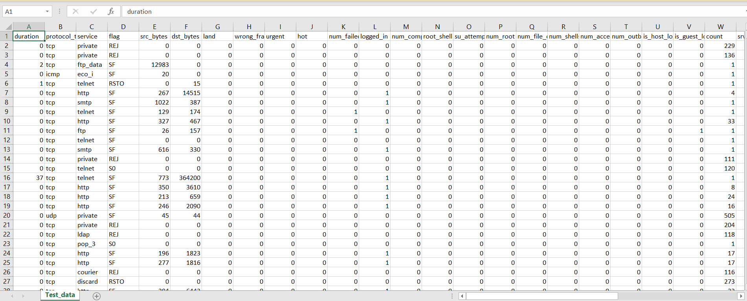
Overview of the Dataset
04/12/2024
IT21380396 | Ashra M.F.F. | 24-25J-075

Slide 44
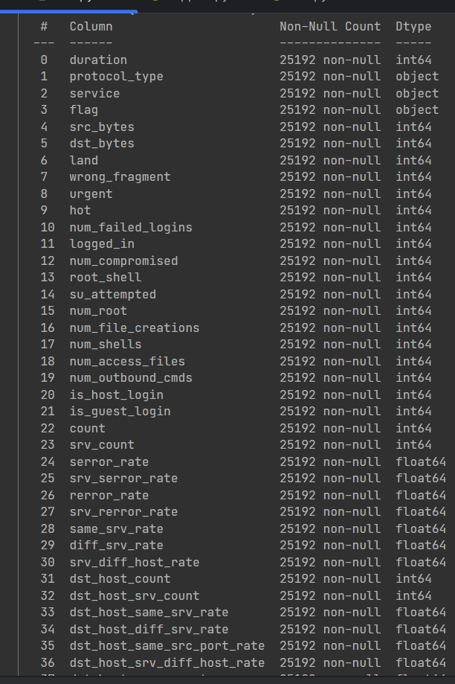
Key Features of the Dataset
Numerical Features (Quantitative Data):
Duration, src_bytes, dst_bytes, num_failed_logins, serror_rate, srv_serror_rate, rerror_rate, diff_srv_rate, num_root, count
Categorical Features (Qualitative Data):
protocol_type, Service, flag
IT21380396 | Ashra M.F.F. | 24-25J-075
04/12/2024

Slide 45
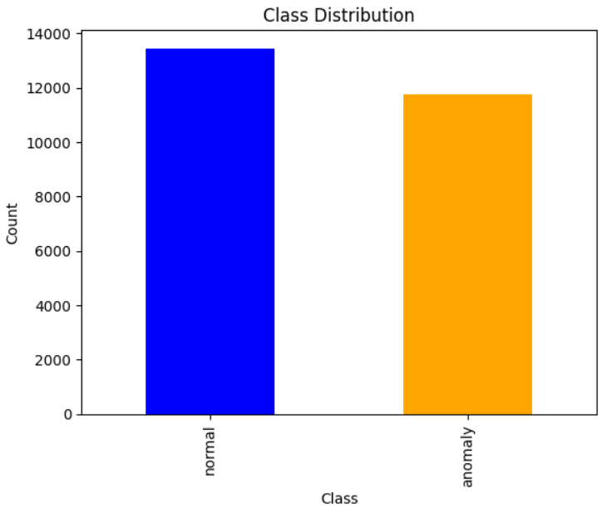

Exploratory Data Analysis (EDA)
Distribution of Target Variable:
Visualizes the frequency of each class in the target variable using a bar chart.
IT21380396 | Ashra M.F.F. | 24-25J-075
04/12/2024

Slide 46


Exploratory Data Analysis (EDA)
Correlation Analysis:
The matrix table showing correlation coefficients between each pair of features.
04/12/2024
IT21380396 | Ashra M.F.F. | 24-25J-075

Slide 47


Data Loading
Loading and Previewing the Dataset
load the dataset into a DataFrame using pandas and previews the first 5 rows.
IT21380396 | Ashra M.F.F. | 24-25J-075
04/12/2024

Slide 48





Data Preprocessing
Checking Data Types:
Summary Statistics:
Handling Missing Data:
IT21380396 | Ashra M.F.F. | 24-25J-075
04/12/2024

Slide 49


Feature Encoding & Scaling
One-Hot Encoding:
Converts categorical columns into numeric format using one-hot encoding.
IT21380396 | Ashra M.F.F. | 24-25J-075
04/12/2024

Slide 50

Model Training
Train-Test Split:
The dataset is split into 80% training and 20% testing.
The model will be trained on X_train (features) and evaluated on X_test (features), with y_train and y_test as target labels (Normal vs Anomalous).
IT21380396 | Ashra M.F.F. | 24-25J-075
04/12/2024

Slide 51


Model Training
Random Forest Classifier - Accuracy and Metrics:
By training and evaluating the Random Forest model, it can assess how well it can distinguish between normal and anomalous network traffic (intrusions).
The classification report and confusion matrix help to identify potential areas for improvement in the model, such as reducing false positives or false negatives.
The overall accuracy gives a sense of how reliable the model is, while the detailed metrics show specific areas where the model may be misclassifying traffic.
04/12/2024
IT21380396 | Ashra M.F.F. | 24-25J-075

Slide 52


Feature Importance Visualization
visualize which features in the dataset are most important for predicting whether network traffic is normal or anomalous.
04/12/2024
IT21380396 | Ashra M.F.F. | 24-25J-075

Slide 53

Model Training
Neural Network Model and Architecture:
Data Encoding: Converts target labels from categorical to numerical values.
Model Structure: Sequential neural network with ReLU and Sigmoid activations.
Training: Model trained for 20 epochs with Adam optimizer and binary cross-entropy loss.
Evaluation: Model evaluated on test data, and performance metrics as accuracy, classification report, and confusion matrix are generated to assess the model's effectiveness in detecting anomalies in network traffic
IT21380396 | Ashra M.F.F. | 24-25J-075
04/12/2024

Slide 54


Model Training
Train and Test the Neural Network Model:
04/12/2024
IT21380396 | Ashra M.F.F. | 24-25J-075

Slide 55



Model Prediction
Feature Selection and Dataset Reduction:

Slide 56


Model Prediction
Model Retraining with Reduced Features:

Slide 57


Model Prediction
Model Retraining with Reduced Features:

Slide 58



Model Evaluation
load the saved Random Forest model and scaler, scales the new sample data, and then uses the trained model to predict the class (normal or anomalous).

Slide 59

Organizational Threat profiling with Physical Security Systems
IT21058196 | K.P.A.T. Gunawardhana
specialize in cybersecurity

Slide 60
Overview
This project uses deep learning to profile organizational threats in physical security, utilizing the UCF-Crime dataset.
The model is based on DenseNet121, a pre-trained network for feature extraction, followed by custom layers for classification.
Images are preprocessed through resizing, augmentation, and normalization.
The model is trained with the Adam optimizer, with performance evaluated using accuracy, AUC, precision, and recall.
After training, the model is saved in both TensorFlow SavedModel and Keras .h5 formats.
Real-time predictions are made by preprocessing input images and classifying them into 14 security threat categories, providing an effective solution for threat detection.
04/12/2024
IT21058196 | Gunawardhana K.P.A.T. | 24-25J-075
60

Slide 61

Overview dataset
The dataset contains extracted images from the UCF crime dataset used for Real-world Anomaly Detection in Surveillance Videos.
04/12/2024
IT21058196 | Gunawardhana K.P.A.T. | 24-25J-075

Slide 62
Overview dataset
All the images are of size 64*64 and in .png format
This Dataset contains a total of 14 classes: Abuse, Arrest, Arson, Assault, Burglary, Explosion, Fighting, Normal Videos, Road Accidents, Robbery, Shooting, Shoplifting, Stealing, and Vandalism.
The total image count for the train subset is 1,266,345.
The total image count for the test subset is 111,308.
04/12/2024
IT21058196 | Gunawardhana K.P.A.T. | 24-25J-075

Slide 63

Data Loading and Pre-Processing
This defines data augmentation and preprocessing steps for the training and testing datasets using TensorFlow's "ImageDataGenerator" function.
04/12/2024
IT21058196 | Gunawardhana K.P.A.T. | 24-25J-075

Slide 64


Data Loading and Pre-Processing
This creates a training data generator that will load images from the specified directory and apply the transformations defined in the "train_datagen".
This defines a test data generator, which loads images from the test dataset, applies preprocessing steps, and generates batches of images and their corresponding labels.
04/12/2024
IT21058196 | Gunawardhana K.P.A.T. | 24-25J-075
64

Slide 65

Data distribution among the classes
Train data Distribution - This generates a bar plot using Plotly Express (`px.bar`) to visualize the distribution of images across different classes in the training dataset. The plot displays how many images are present for each class in the dataset, and it uses color to differentiate between classes.
04/12/2024
IT21058196 | Gunawardhana K.P.A.T. | 24-25J-075

Slide 66

Data distribution among the classes
Test data Distribution - This generates a bar plot using Plotly Express (`px.bar`) to visualize the distribution of images across different classes in the test dataset. The plot displays how many images are present for each class in the test dataset, and it uses color to differentiate between classes.
04/12/2024

Slide 67


DenseNet121 Transfer Learning
This defines a complete deep learning model using TensorFlow and Keras, based on the DenseNet121 architecture for image classification tasks. The model is divided into three components: a feature extractor, a classifier, and a final model that combines both. After defining the model structure, it compiles the model and prints the summary.
04/12/2024
IT21058196 | Gunawardhana K.P.A.T. | 24-25J-075

Slide 68

DenseNet121 Transfer Learning
This "feature_extractor" function uses a pre-trained DenseNet121 model as a feature extractor.
04/12/2024
IT21058196 | Gunawardhana K.P.A.T. | 24-25J-075

Slide 69

DenseNet121 Transfer Learning
This "classifier" function defines the custom classifier part of the model.
Used GlobalAveragePooling2D layer to reduces the spatial dimensions (height and width) of the feature maps to a single number per feature map.
Three Dense layers are added with ReLU activation functions.
The final layer uses the Softmax activation function, which converts the output into a probability distribution over all classes.
04/12/2024
IT21058196 | Gunawardhana K.P.A.T. | 24-25J-075

Slide 70
Training the Model
The code is used to train the neural network model on the training data and evaluate its performance on the validation data.
Accuracy of the mode is 0.7622
04/12/2024
IT21058196 | Gunawardhana K.P.A.T. | 24-25J-075

Slide 71


Multiclass AUC Curve
This evaluates the model's performance on the test dataset using the ROC (Receiver Operating Characteristic) AUC (Area Under the Curve) metric for multi-class classification. It plots the ROC curve for each class and calculates the overall AUC score.
IT21058196 | Gunawardhana K.P.A.T. | 24-25J-075

Slide 72


Saving the Model in SavedModel Format
This saves the trained TensorFlow model in the SavedModel format, which is a comprehensive format for TensorFlow models. It includes the model architecture, weights, and other metadata necessary for deploying or further training the model.
Saving the Model in Keras Format
This cell saves the trained model in the Keras HDF5 format using the "model.save()" function.
04/12/2024
IT21058196 | Gunawardhana K.P.A.T. | 24-25J-075

Slide 73

Model Architecture Summary
This code loads an image, preprocesses it to match the format required by the model, and then makes a prediction using the trained model. It outputs the predicted class label for the image.
04/12/2024
IT21058196 | Gunawardhana K.P.A.T. | 24-25J-075

Slide 74

Thank you

